Slide 1
Feed Formulation
Group 7
Member:
Đỗ Tấn Liêm
Nguyễn Thế Vinh
Nguyễn Hữu Phúc
Nguyễn Bảo Duy
Supervisor:
Lâm Hữu Khánh Phương

Slide 2
Introdution
Featured Solution
Technology
Scenario Problem
Demonstration
Future Plan
Q&A

Slide 3
Introduction
Livestock plays an important role in generating rural income in Vietnam
The analysis or animal growth as a response to feeding has a long history in both animal science and agricultural economics

Slide 4
Scenario Problem
Feed formulation and feed management have been major concerns to poultry nutritionists all over the world.
Too expensive for small-scale farmers to be able to adopt them.
Lack of informations

Slide 5
Featured Solution
Easy to manage ingredients and nutrients
Support multiple ingredients and nutrients.
Optimize way to use ingredient to produce feed with lowest price.

Slide 6
Feed Formulation steps
Step 1 Ingredient
Input ingredient constraints
Step 2 Nutrient
Input nutrient constraints
Step 3 Formulation
Solve formulation

Slide 7
Example
Bắp
Lysine | 0.2%
Năng lượng trao đổi (DE) | 1500 Kcal/kg
Cám gạo
Lysine | 0.44 %
Năng lượng trao đổi (DE) | 2100 Kcal/kg
2300đ/kg
2600đ/kg

Slide 8
Example
Lập công thức thức ăn cho heo. Yêu cầu:
Tổng khối lượng: 100 kg
0.3 % ≤ Lysine ≤ 0.35 %
1500 Kcal ≤ DE ≤ 2000 Kcal

Slide 9
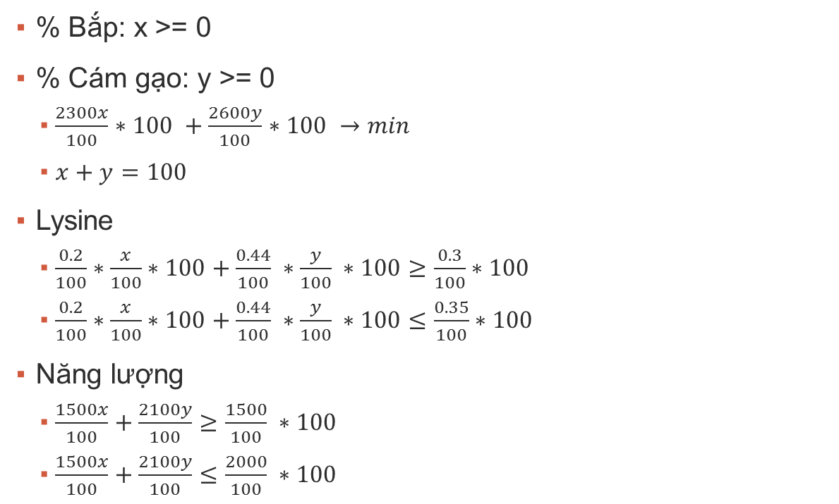
Example
% Bắp: x >= 0
% Cám gạo: y >= 0
$\frac{2300x}{100}∗100 +\frac{2600y}{100}∗100 →min$
$x+y=100$
Lysine
$\frac{0.2}{100}∗\frac{x}{100}∗100+\frac{0.44}{100} ∗\frac{y}{100} ∗100≥\frac{0.3}{100}∗100$
$\frac{0.2}{100}∗\frac{x}{100}∗100+\frac{0.44}{100} ∗\frac{y}{100} ∗100≤\frac{0.35}{100}∗100$
Năng lượng
$\frac{1500x}{100}+\frac{2100y}{100}≥\frac{1500}{100} ∗100$
$\frac{1500x}{100}+\frac{2100y}{100}≤\frac{2000}{100} ∗100$

Slide 10

Example
X = 58.333
Y = 41.667
$2300x+2600y→min$
$0.002x+0.0044y≥0.3$
$0.002x+0.0044y≤0.35$
$15x+21y≥15$
$15x+21y≤20$
$x+y=100$

Slide 11




Technologies

Slide 12
Demonstration

Slide 13
Future Plan
Supporting mobiles
Feed Formulation with Professor advices.

Slide 14
Q&A

